Slide 1
MY WEEKLY BALANCED
MENU
MY FIRST WEIGHT:36
MY LAST WEIGHT:37.7

Slide 2
DAY 1 NUTRITION
BREAKFAST MENU
SNACK
HAZELNUT, COOKIE AND FRUIT
LUNCH MENU
SNACK
FRUIT, PASTRY AND TEA
DINNER MENU
JAM, CHEESE,
OLIVE, HONEY, MILK,
TOMATO AND CREPE
SOUP, TEA AND
PASTA
SOUP,
PASTA,
CABBAGE SOUP
AND FRUIT JUICE

Slide 3
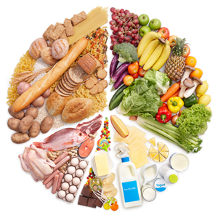
DAY 2 NUTRITION
BREAKFAST
MENU
jam, honey, cheese
egg and tea
snack
fruit, juice, and biscuit
LUNCH MENU
haricot bean,
pasta,
compote
Snack
fritters and juice
DINNER MENU
chicken soup,
rice with chickpeas, tea

Slide 4
DAY 3 NUTRITION
BREAKFAST
MENU
EGG, HONEY,
JAM, TOMATOES AND
MILK
SNACK
FISH CRAKER AND EXPLOSIVE CORN
LUNCH MENU
PASTA AND TEA
SNACK
Pastry and milk
DINNER MENU
PASTA
SOUP TEA
Stuffed Cabbage

Slide 5
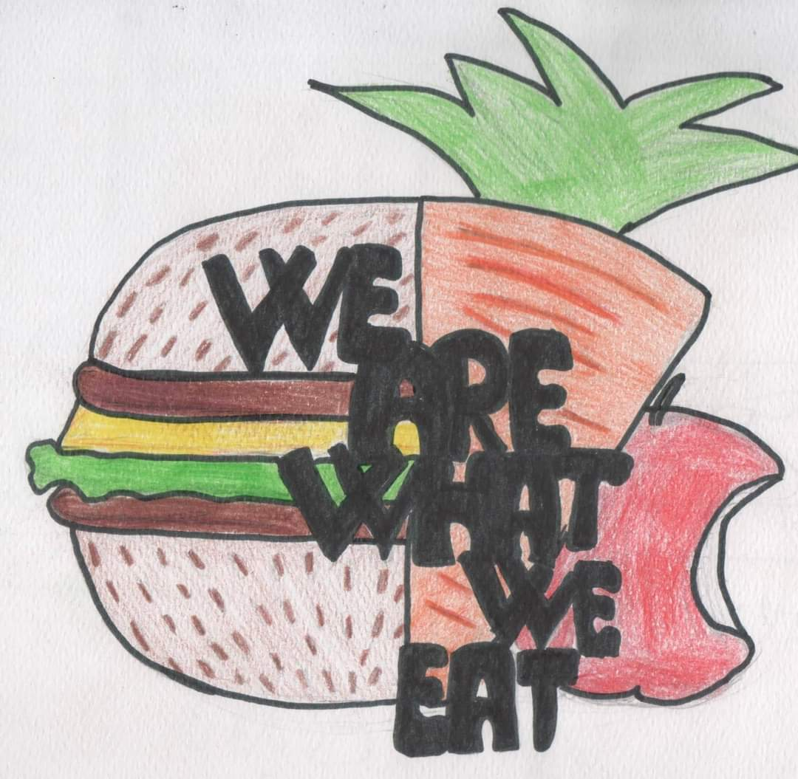
DAY 4 NUTRITION
BREAKFAST
MENU
TEA, OMLET,
JAM, HONEY Grape molasses
SNACK
WALNUT PISTACHIO AND TEA
LUNCH MENU
SOUP AND TEA
SNACK
PASTRY, TEA AND
HAZELNUT
DINNER MENU
STUFFED PEPPERS,
FRIED AND COMPOSTO

Slide 6
THANKS FOR WATCHING

